Slide 1
The valley
Helec bastien

Slide 2

Summary
Why silicon valley ?
Where is it located?
who carried the project
The beginning of a considerable growth
The companies adding up
The essentials of living there as a start-up
The silicon valley in numbers today
Some questions

Slide 3
Why silicon valley ?
Silicium (use for create semi-conductors)

Slide 4
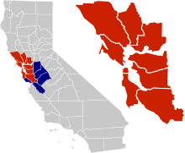
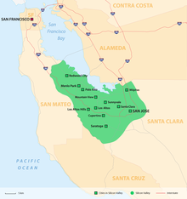
Where is it located?
South of San Fransisco , in California

Slide 5
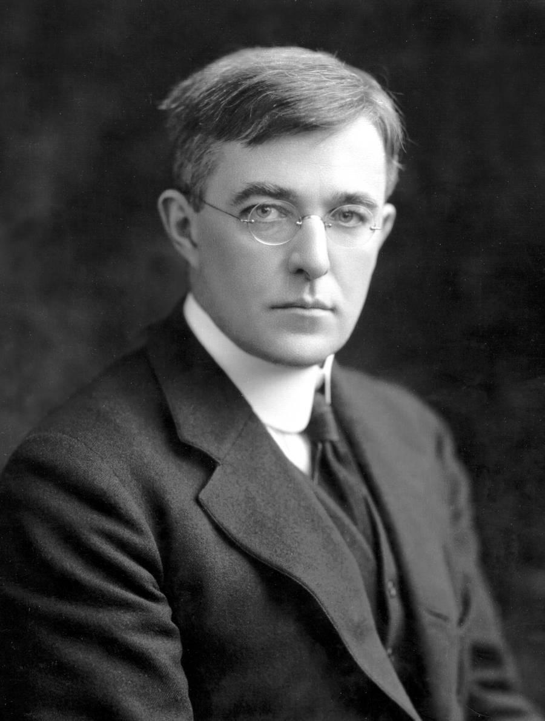
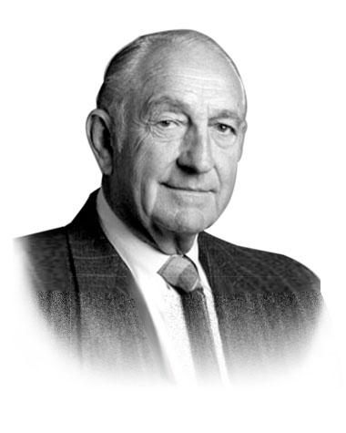
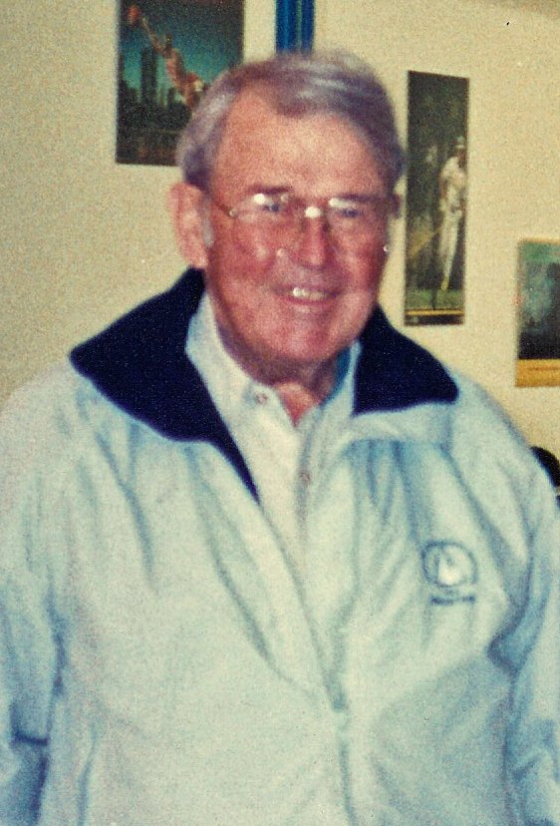
who carried the project ?
Frederick terman
David Packard
William Helwett

Slide 6
The beginning of a considerable growth
First time , companies on semi-conductors
(intel , AMD, Texas Instruments)
Secondly, all biotechnology companies and more
(Google , Apple …)

Slide 7
The companies, adding up:
Google
Apple
Adobe
…

Slide 8
The essentials of living there as a start-up
Socializing
Accesibilities of acknowledgement
High salaries
accessibilities to the sea

Slide 9
Silicon Valley in figures
More than 6 000 companies
More than 416 000 employees

Slide 10
Some questions
-Who allowed the creation of the silicon valley
-Where is it located?
-What was the first company to participate in the program?
- What is the number of companies present today in the silicon valley

Slide 11
source
https://www.futura-sciences.com/tech/definitions/tech-silicon-valley-19656/
03/01/2023 20:45
https://fr.wikipedia.org/wiki/Silicon_Valley 03/01/2023 20:45

